Slide 1
MovieDB
Functionality
  CRUD For Movie, Cast Members and Genre
  Search for and import Movies and Cast Members using the Data-imdb API
  https://rapidapi.com/SAdrian/api/data-imdb1/

Slide 2
Stack
Bootstrap 5
Spring
Google Material Icons
jQuery
Thymeleaf

Slide 3
API
  https://rapidapi.com/SAdrian/api/data-imdb1/
  Api.js

Slide 4
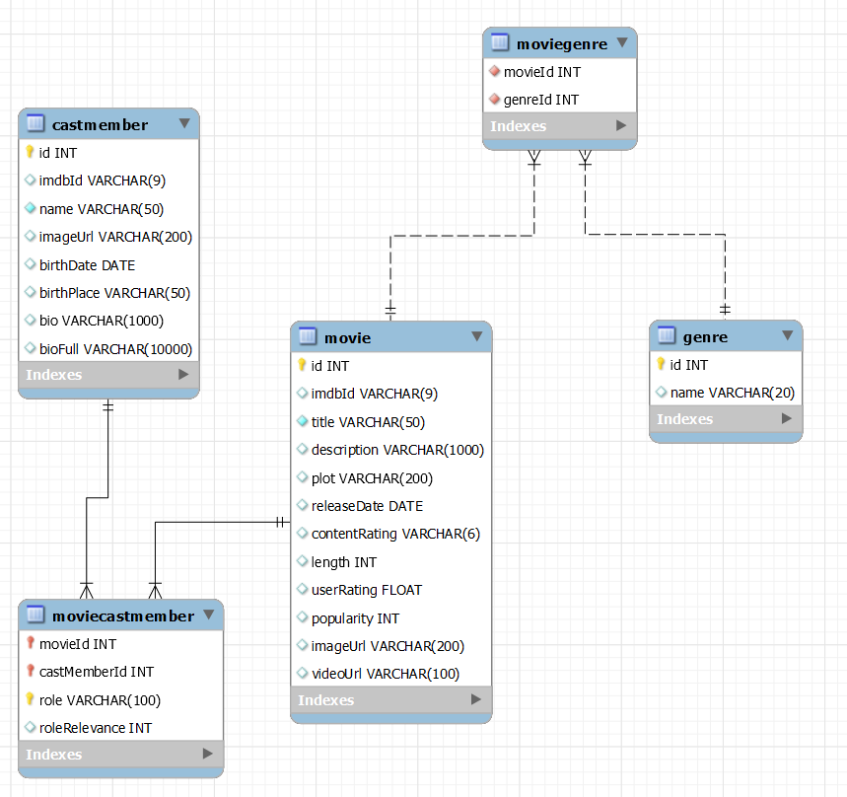
MovieDB ERD

Slide 5
Models
Movie
Genre
CastMember
MovieCastMember

Slide 6
Daos
GenreDao
MovieDao
CastMemberDao

Slide 7
Genre Dao
Basic CRUD Operation

Slide 8
Movie Dao
Basic CRUD Operation
GetMovieByNameAndReleaseDate
GetMoviesCastMemberIn
SearchMoviesByTitle
getTopUserRatedMovies

Slide 9
CastMember Dao
Basic CRUD Operation
SearchCastMembersByName
GetCastMemberByImdbId
getCastMemberByNameAndBirthdate

Slide 10
Current Issues
Choosing VARCHAR size for movie and actor descriptions
  Most are small but some are extremely large
API sometimes provides duplicate cast members
  Spider-man 3 :(

